Slide 1


Vessel segmentation in computed scans of lungs
Polytechnic of Milan – 6th of June 2022
Giampiero Porfiri
giampiero.porfiri@mail.polimi.it
NL1 research project

Slide 2
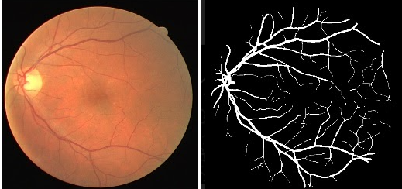
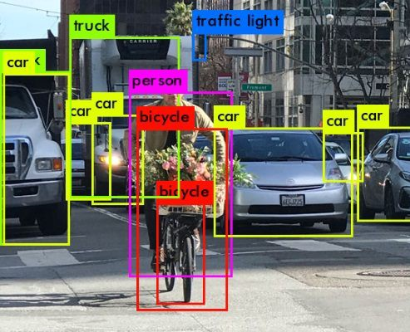
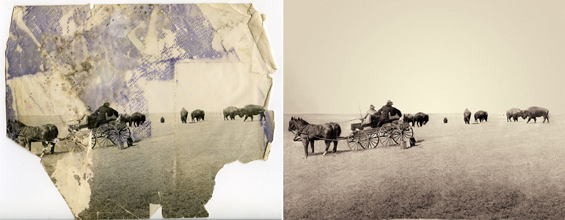
Introduction
What is image processing?
Image processing is the manipulation of an image with the purpose of extracting useful information out of it.
From left to right: vessel segmentation of the retina [1], recognition and image classification [2], photograph restoration [3].
2

Slide 3
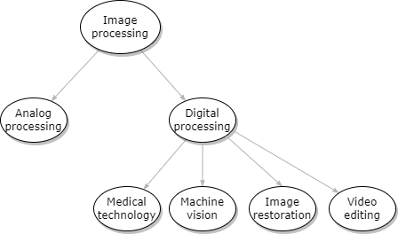
Introduction
3

Slide 4
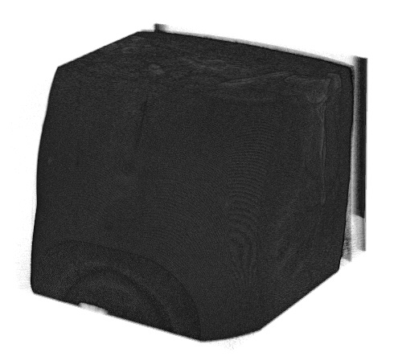
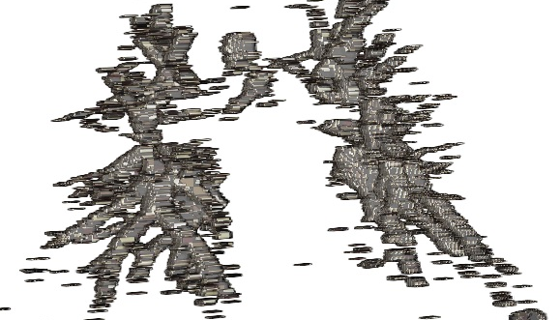
Objectives
The main goals of this work are the following:
Enhance the slices obtained from 3D models.
Segment the images.
Select the major vessels and construct a 3D volume.
4
The initial volume and the output.

Slide 5
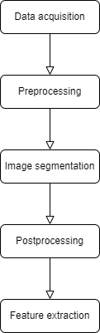
Procedure
To complete the objectives, the process is divided into steps.
MATLAB is the chosen programming language, because of its versatility and how well documented it is.
5

Slide 6
Dataset
The dataset includes twenty meta image medical format scans and their respective masks.
The number of slices per volume and their quality is variable.
Three additional scans were provided with additional ground truth tables, which are used to measure the quality of the results.
A slice of a metaImage file.
6

Slide 7

Algorithm
Preprocessing
The slices are extracted and the precision is increased to double.
Then, they are masked with the provided masks.
CLAHE algorithm is finally used to enhance the grayscale image.
A few clusters are obtained through preprocessing.
7

Slide 8
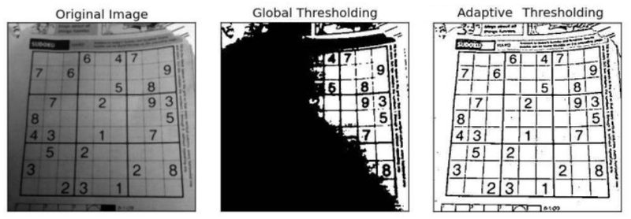
Algorithm
Contrast-limited Adaptive Histogram Equalization (CLAHE)
Global and CLAHE thresholding are compared [4].
8

Slide 9
Algorithm
Image segmentation
A filter is built upon the average value of the grey intensity in the enhanced image.
Subsequently, the filter is bitwise subtracted from the enhanced image.
Otsu’s algorithm is applied to the byproduct of the subtraction
9

Slide 10
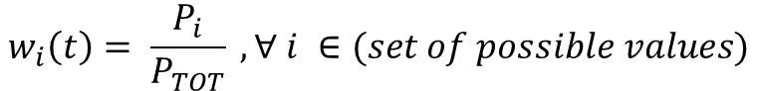

Algorithm
Otsu’s thresholding
It is based on finding the optimal threshold value which maximizes the weighted inter-class variance (and minimizes the intra-class variance).
The weights are the uniform probabilities of the two classes separated by a threshold t.
$$w_{i}\left(t\right)= \frac{P_{i}}{P_{TOT}} , ∀ i ∈(set of possible values)$$
$$σ_{w}^{2}\left(t\right)=w_{1}\left(t\right) σ_{1}^{2}\left(t\right)+w_{1}\left(t\right) σ_{2}^{2}\left(t\right) , |set of possible values|=2$$
10

Slide 11
Algorithm
Otsu’s thresholding
A visualization of how the threshold value is chosen.
11

Slide 12
Algorithm
Postprocessing
The final step is to fill empty holes with a maximum of a four-pixel gap in pursuance of enlarging the output.
12
Major vessels are highlighted through enlargement.

Slide 13
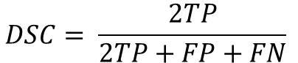
Results
The Sørensen–Dice coefficient is used to measure the similarity between the processed images and the ground truth ones.
$$DSC= \frac{2TP}{2TP+FP+FN}$$
# dataset | DSC
21 | 0.758
22 | 0.742
23 | 0.724
13

Slide 14
Conclusions
Observations
Different approaches can be tested: there isn’t any «perfect» algorithm owing to the different scenarios it can be exposed to.
Future perspectives
The research could further be explored by comparing different image processing methods.
14

Slide 15
References
Images
Figure 1: https://miro.medium.com/max/1038/1*4_jr47zotDptNG0Qyg7WSg.png
Figure 2: https://miro.medium.com/max/800/1*u3SAkFbIQHBC8hSifHUMeA.jpeg
Figure 3: https://upload.wikimedia.org/wikipedia/commons/7/73/Bison_restored_sm.jpg
Figure 4: https://upload.wikimedia.org/wikipedia/commons/thumb/3/34/Example_of_adaptive_thresholding.png/800px-Example_of_adaptive_thresholding.png
15

